Slide 1
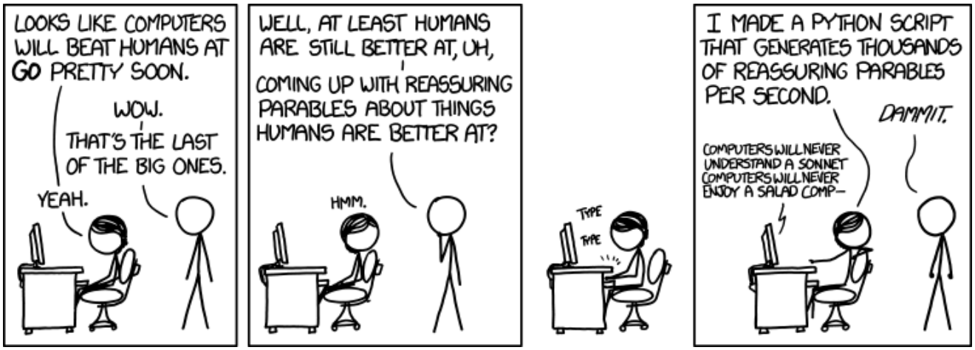
Chapter 1 Natural Language Processing

Slide 2

About ME
Research
Recommender Systems
Natural Language Processing
Projects
LibRec、LibDL、IdeaMan
Contact
http://faculty.neu.edu.cn/swc/guogb/index.html
https://guoguibing.github.io/
Email: guogb@swc.neu.edu.cn
Address: Room B444, Information Building

Slide 3
Objectives
What will you get out of this class?
Understanding a major field of AI
Basic machine learning skills
Ideas that you could transform into a startup company or academic research

Slide 4

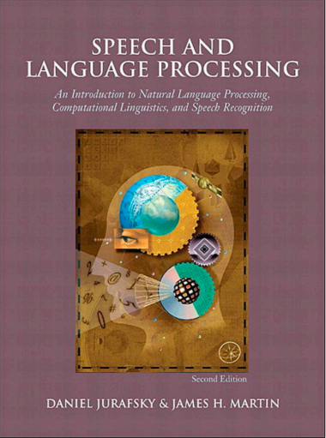
Textbooks
http://web.stanford.edu/~jurafsky/slp3/ed3book.pdf

Slide 5
Course Contents
Chapter 1: Introduction
Chapter 2: Basic Text Processing
Chapter 3: Language Modeling with N-grams
Chapter 4: Text Classification
Chapter 5: Part-of-Speech Tagging
Chapter 6: Sequence Processing with Recurrent Network
Chapter 7: Question Answering and Summarization
Chapter 8: Information Extraction (NER, RE)
Chapter 9: Machine Translation (optional)
Chapter 10: Dialog Systems and Chatbots (optional)

Slide 6
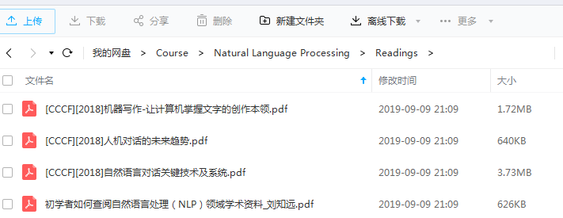
Course Contents (2)
Sharing Link:
https://pan.baidu.com/s/1K9G8hHfGxoFHPZlCf3I1xw
Extraction Code: qqoe

Slide 7
Grading
15% presence & participation
40% homework assignment 1
45% homework assignment 2

Slide 8
Class Regulation
Rules to follow
Yes to pose a question at any time
Yes to correct me if any
No gaming (a waster of time)
No cellphone (a strong distraction)
No whisper (ruin my day)

Slide 9
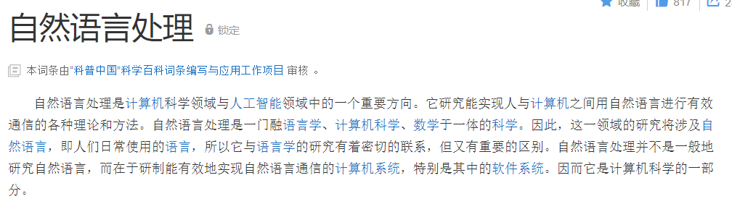
What is NLP?
Natural Language Processing converts unstructured text into machine actionable data.
Max Irwin, Managing consultant, opensource connections.

Slide 10
NLP Tasks
Natural Language Understanding (NLU)
Error Correction
Speech Recognition
Machine Translation
Question Answering
Summarization
Natural Language Generation (NLG)
Text Generation
News, Paper, Reports, Poem, Spring Couplets

Slide 11
NLP Branches
https://nlpprogress.com/
Automatic speech recognition
CCG supertagging
Common sense
Constituency parsing
Coreference resolution
Dependency parsing
Dialogue
Domain adaptation
Entity linking
Grammatical error correction
Information extraction
Language modeling
Lexical normalization
Machine translation
Multi-task learning
Multi-modal
Named entity recognition
Natural language inference
Part-of-speech tagging
Question answering
Relation prediction
Relationship extraction
Semantic textual similarity
Semantic parsing
Semantic role labeling
Sentiment analysis
Shallow syntax
Stance detection
Summarization
Taxonomy learning
Temporal processing
Text classification
Word sense disambiguation

Slide 12
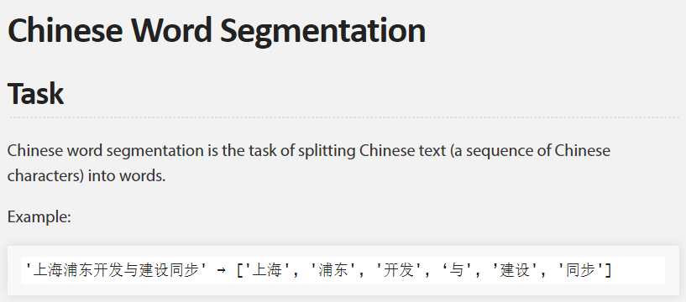
NLP Branches (2)
Chinese
Entity linking
Chinese word segmentation

Slide 13
Useful Links
Google Scholar
A curated list of speech and natural language processing resources: https://github.com/edobashira/speech-language-processing
Speech and Language Processing, 2nd Edition in PDF format: https://github.com/rain1024/slp2-pdf
Speech and Language Processing, 3rd Edition draft: http://web.stanford.edu/~jurafsky/slp3/
https://www.aclweb.org/portal/
Conferences: ACL (NAACL, EACL), EMNLP, COLING
中国中文信息学会, NLPCC, CCKS
http://www.52nlp.cn/

Slide 14
NLP in the wild
Real-world examples

Slide 15
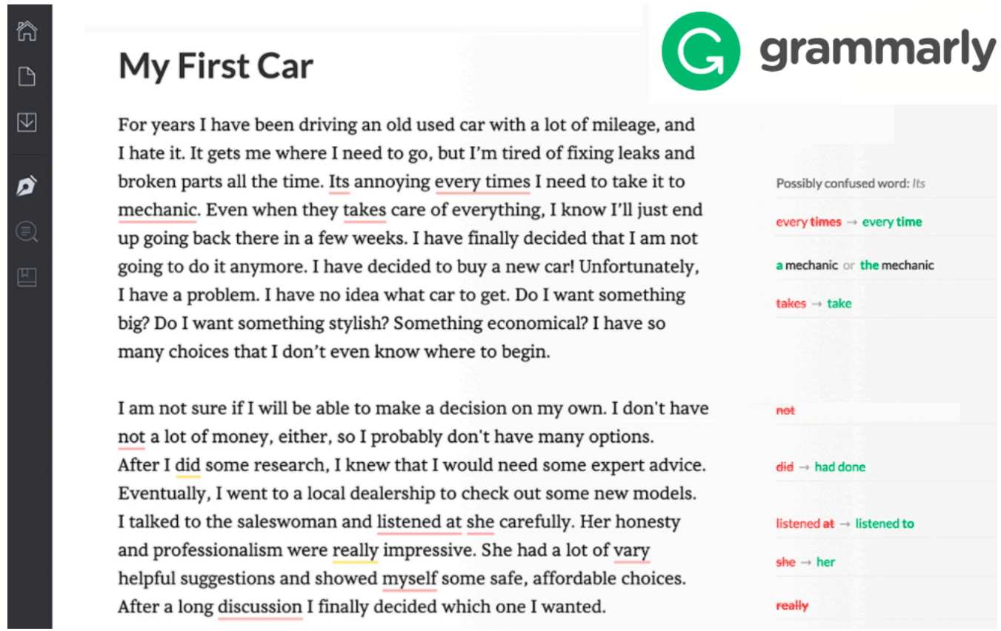
Error Correction

Slide 16

Speech Recognition

Slide 17
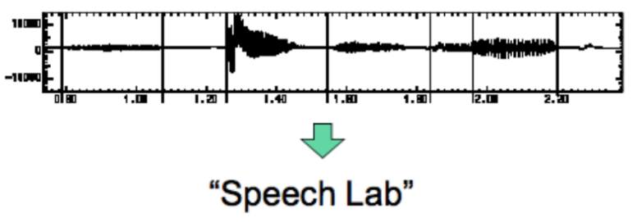
Speech Recognition (2)
Automatic Speech Recognition
Audio In, text out
State-of-the-art: 0.3% error for digit strings, 5% dictation 50%+ for TV

Slide 18
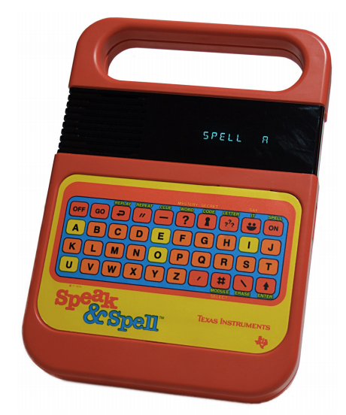
Speech Interfaces
Text to speech
Text in, audio out
https://www.youtube.com/watch?v=QPk8mR6f3jo

Slide 19
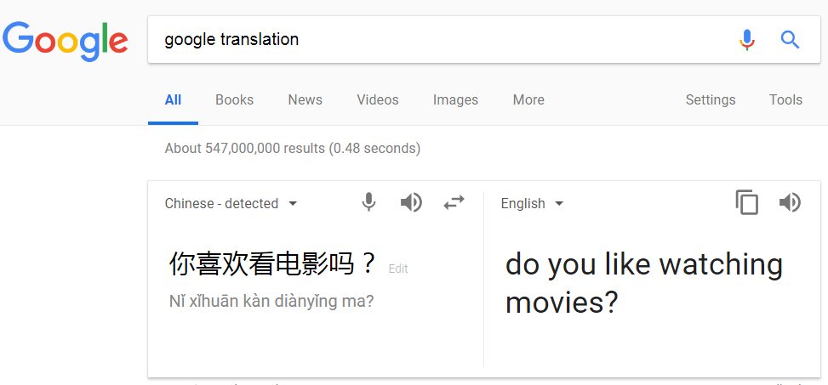
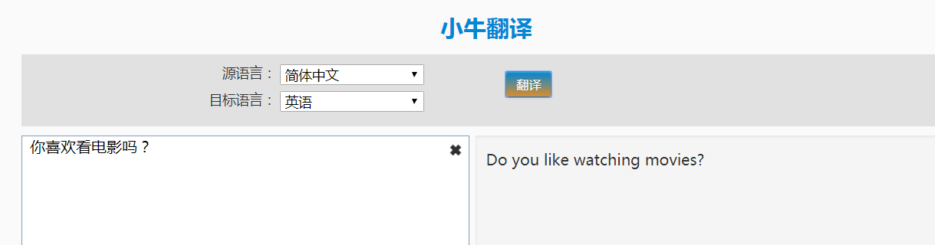
Machine Translation

Slide 20
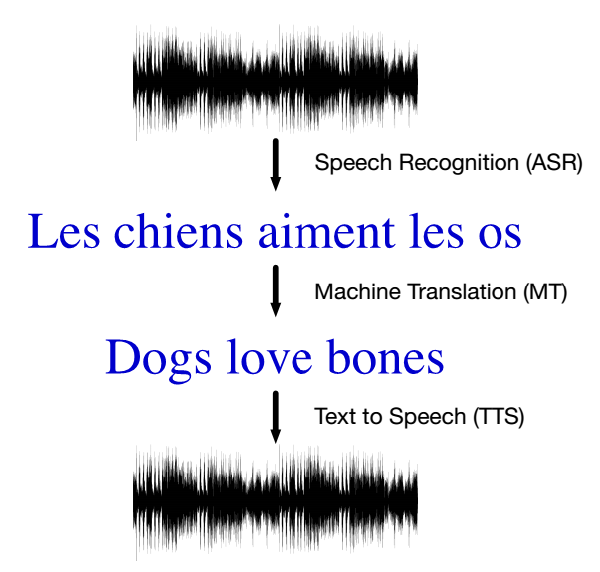
Speech Processing & Machine Translation

Slide 21
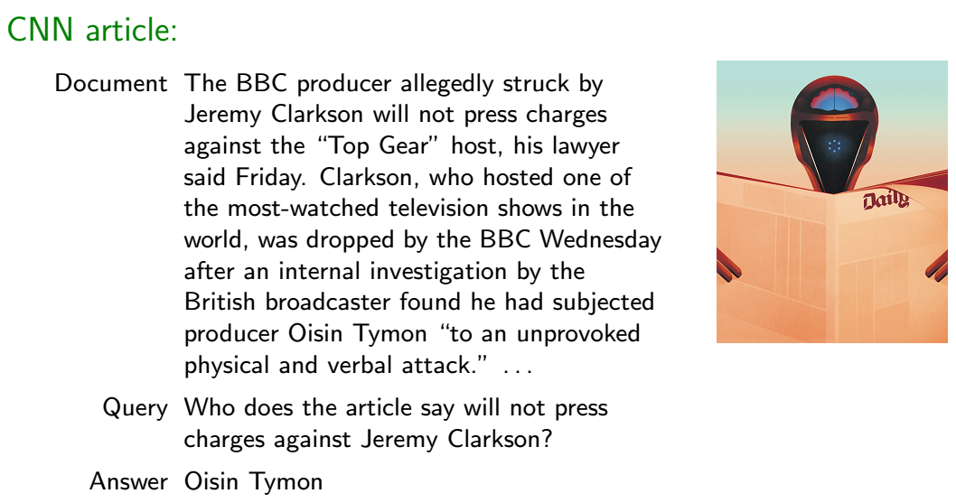
Question Answering

Slide 22
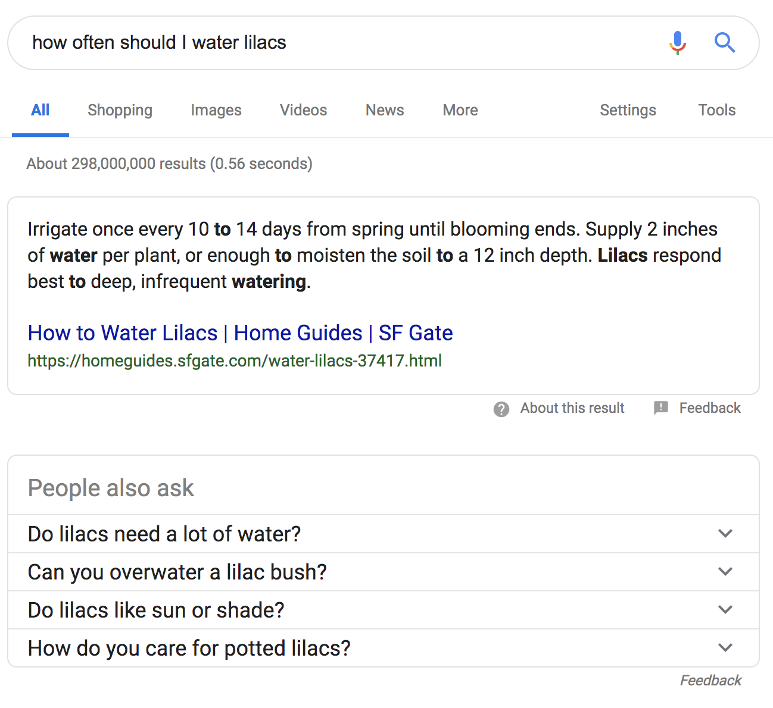
Question Answering (2)
“how often should I water lilacs”
→ “...every 10 to 14 days…”
The query was analyzed and used to select an answer as a snippet of text.
Other similar questions are offered.
Notes:
lilas 丁香花

Slide 23
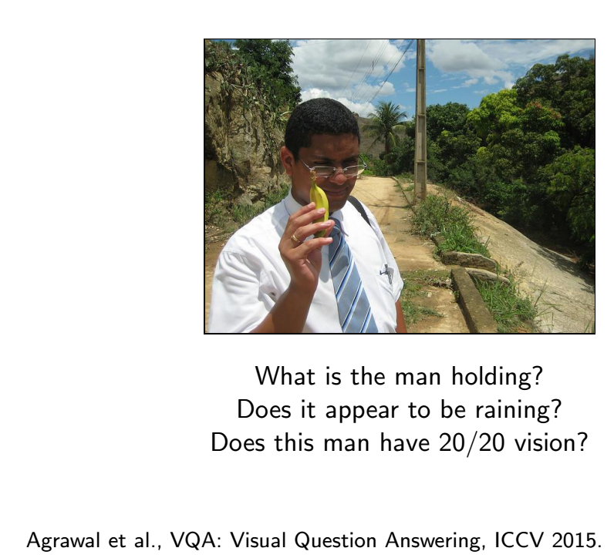
Question Answering (3)

Slide 24
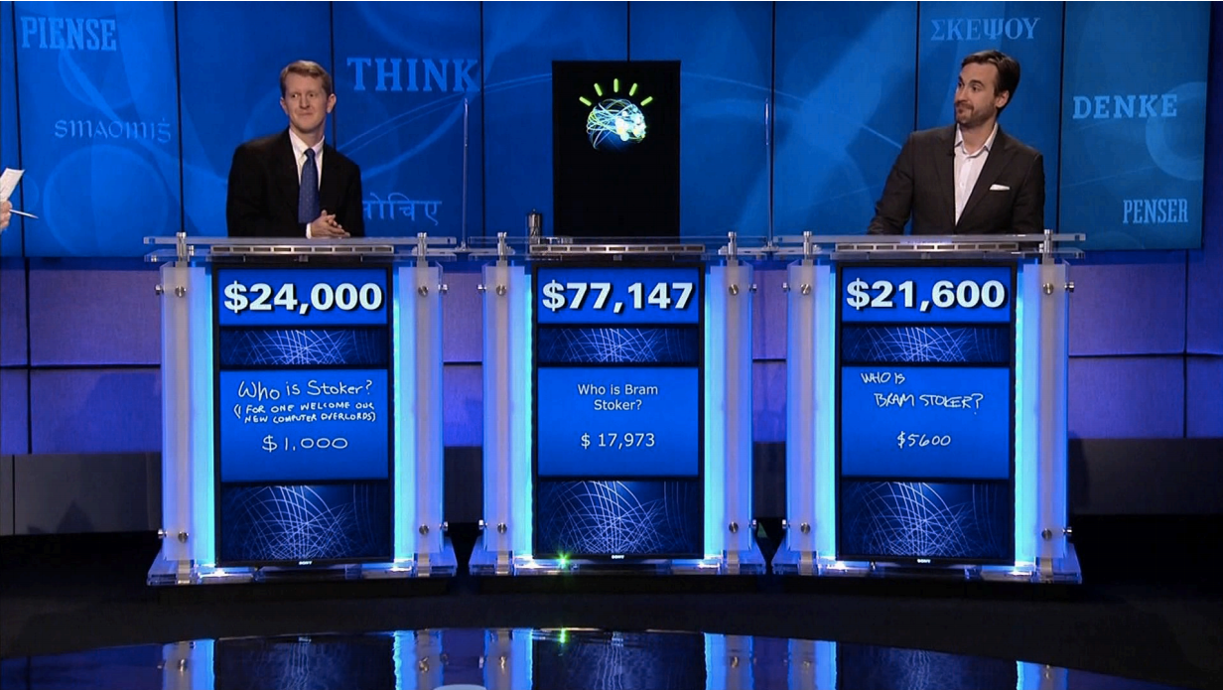
Question Answering (4)

Slide 25
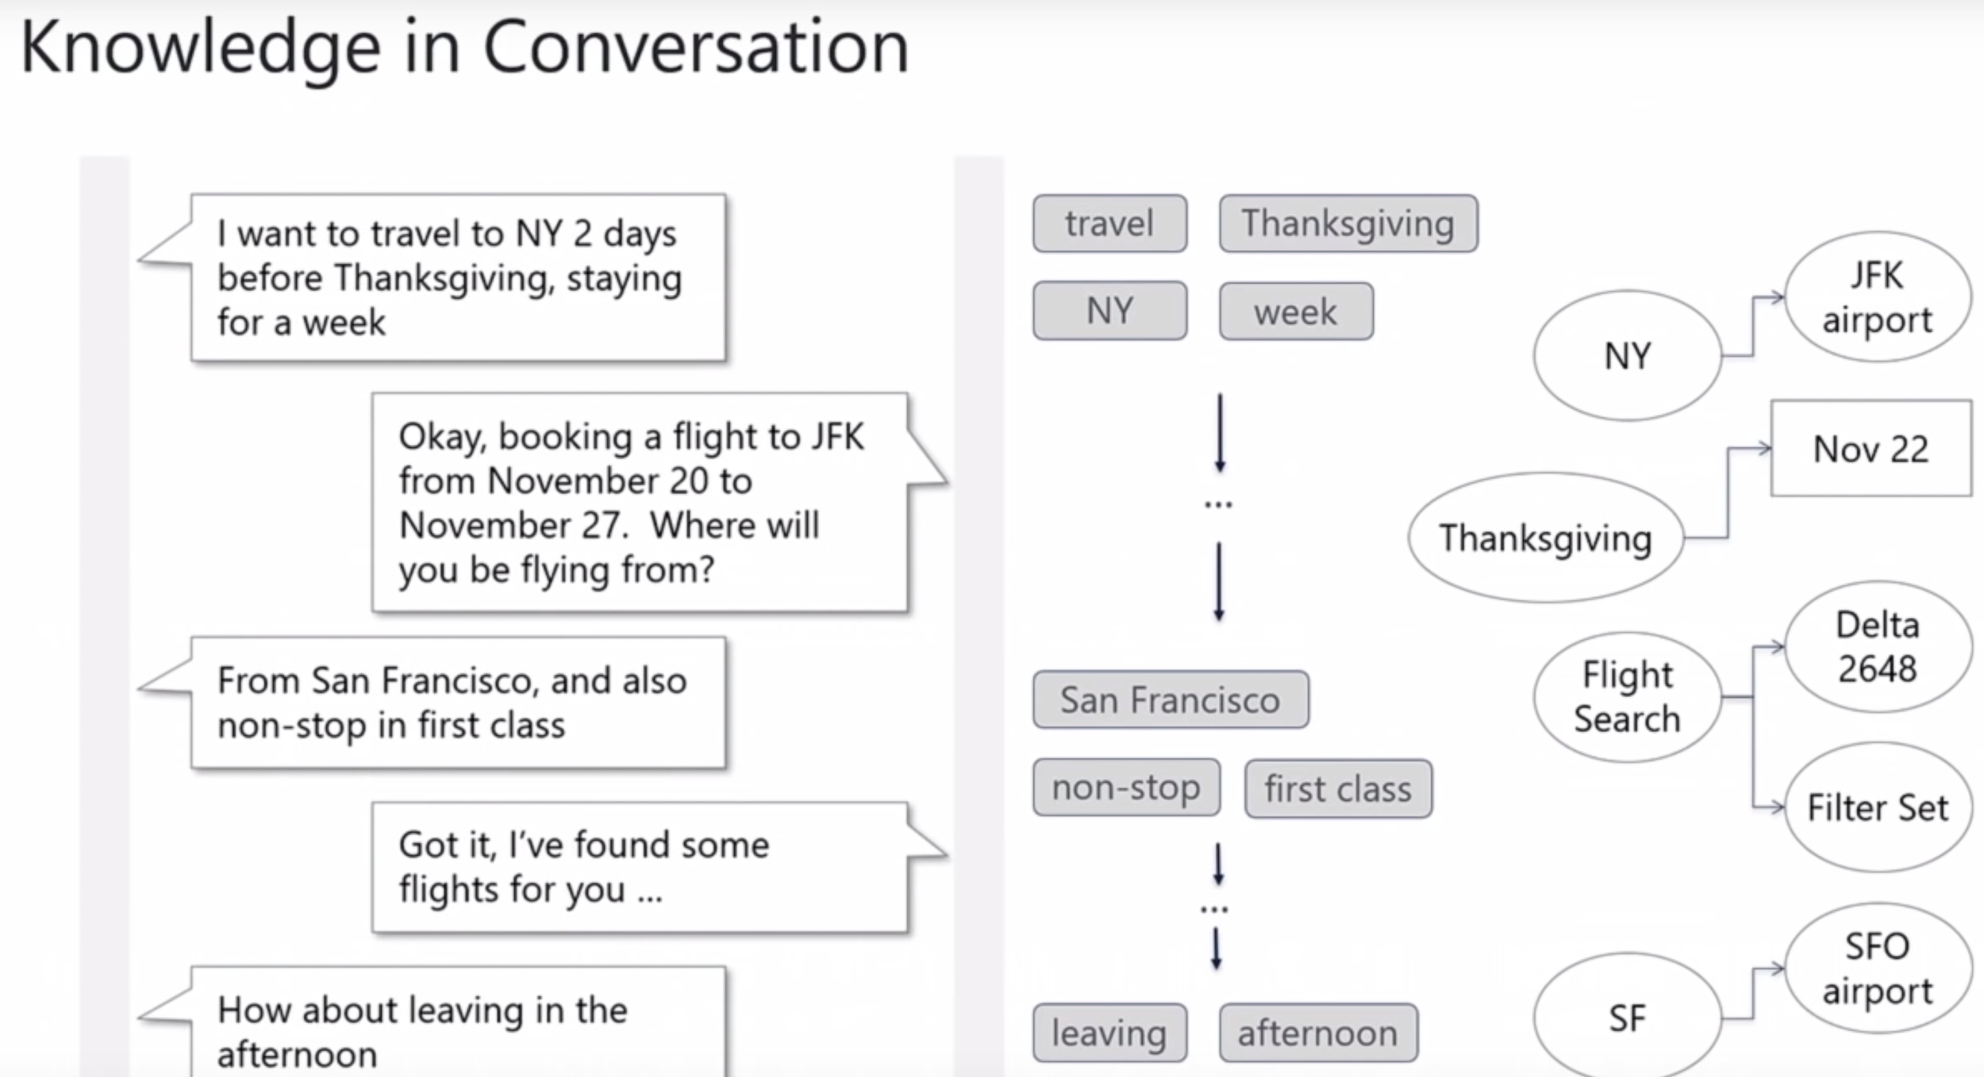
NLP logic for a chatbot

Slide 26
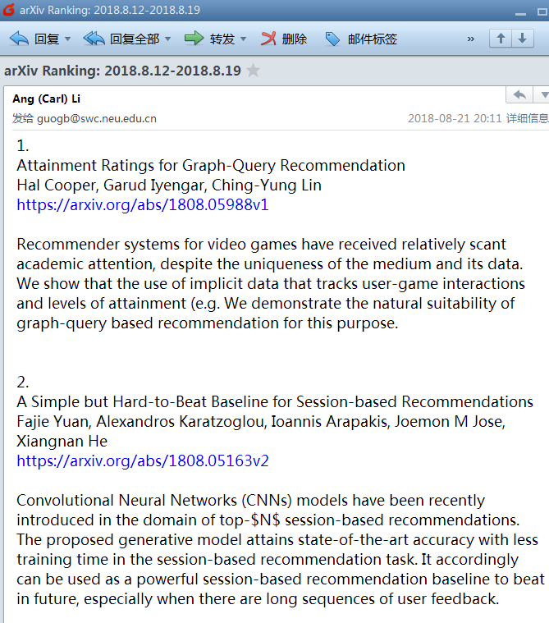
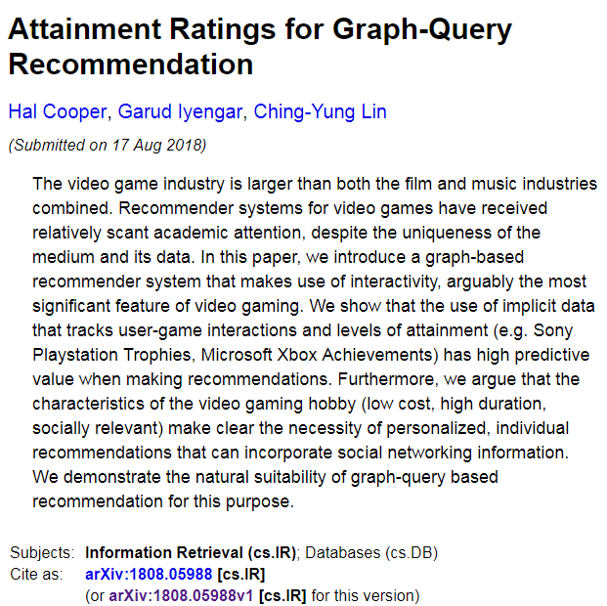

Summarization

Slide 27
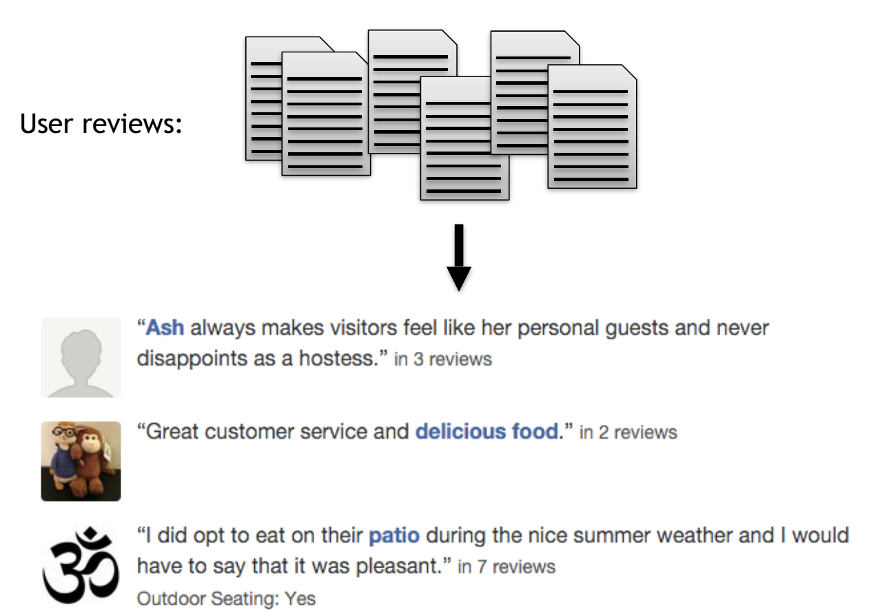
Summarization (2)
https://github.com/icoxfog417/awesome-text-summarization

Slide 28


Spring Couplets
http://couplet.ronghuiad.com/pc.html
https://duilian.msra.cn/default.htm

Slide 29

Word Puzzle
https://duilian.msra.cn/zimi/

Slide 30
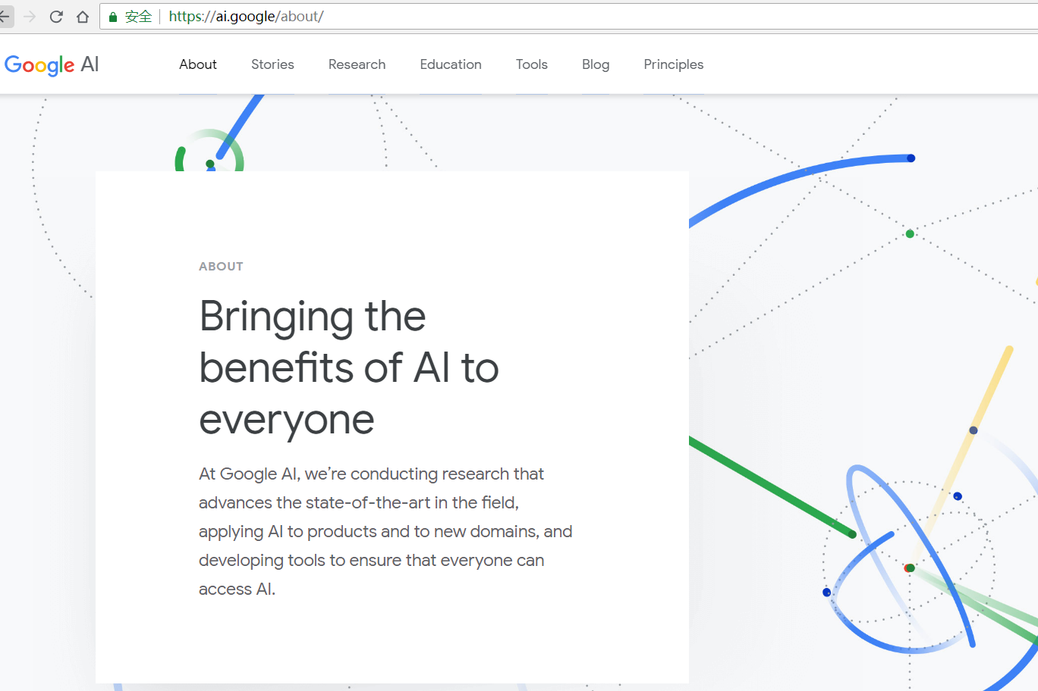
Google AI / DeepMind

Slide 31
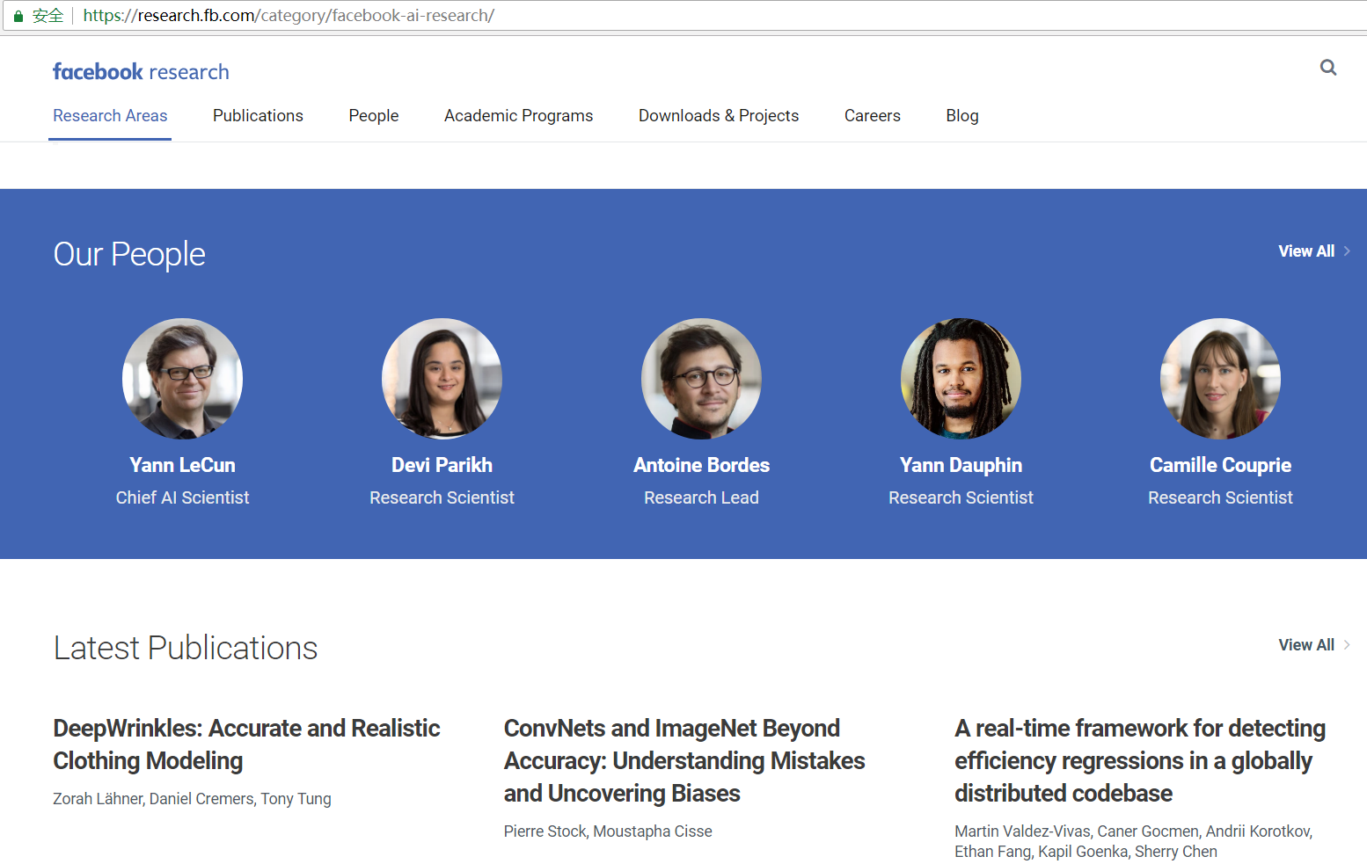
Facebook Research

Slide 32

Microsoft Research

Slide 33
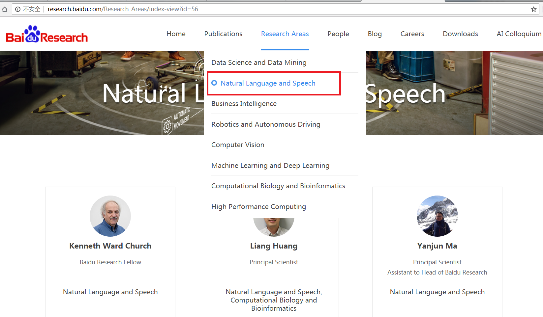
Baidu Research

Slide 34
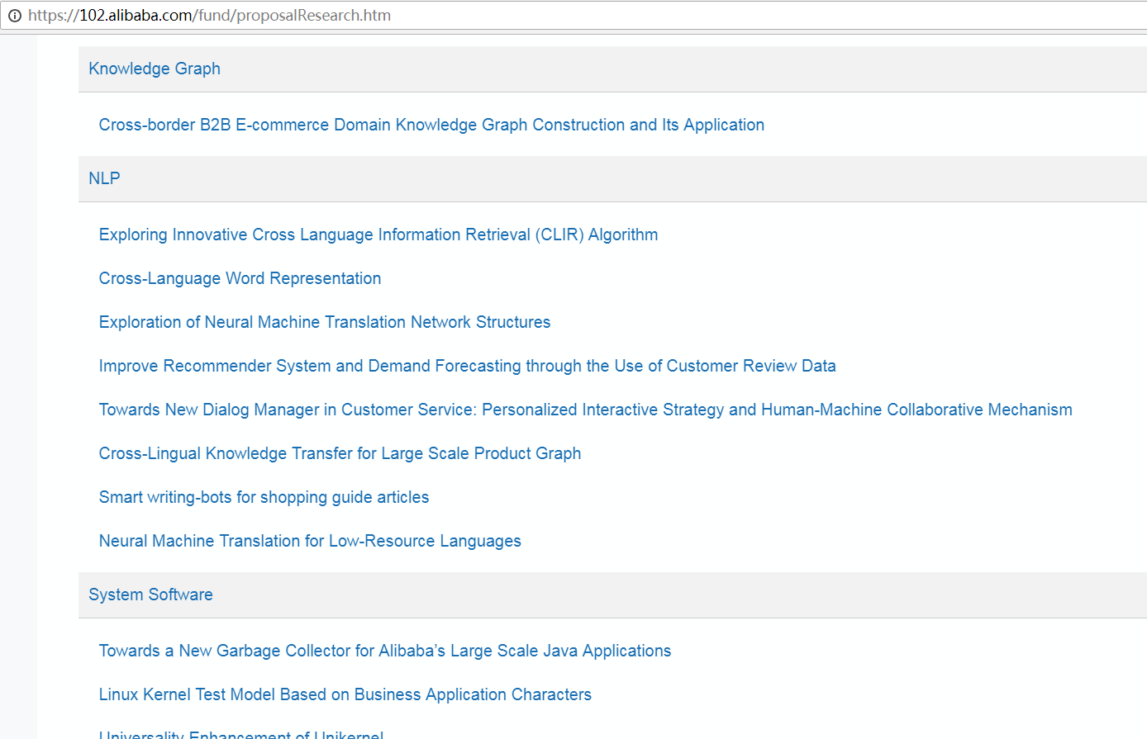
AIR: Alibaba Innovation Research

Slide 35
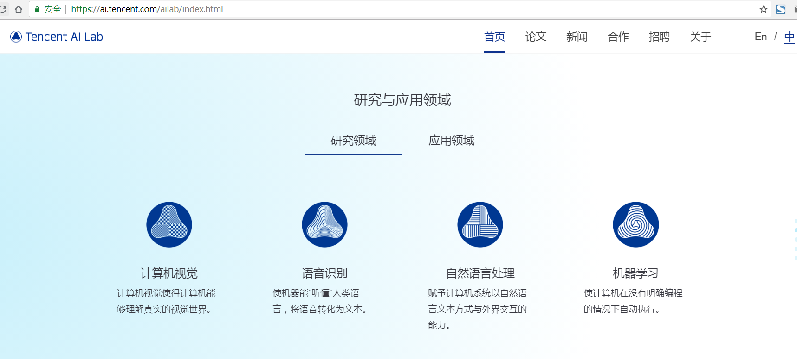
Tencent AI Lab

Slide 36
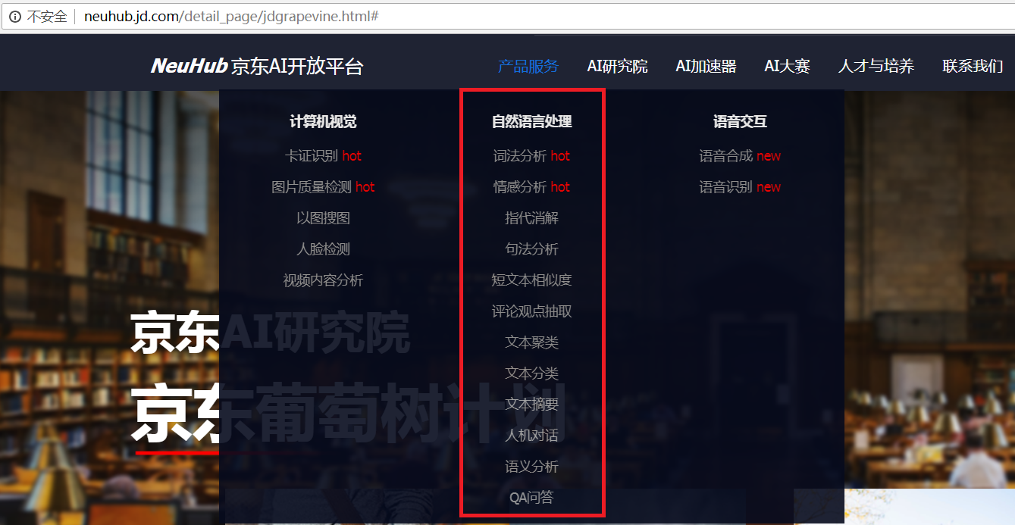
JD AI Lab

Slide 37
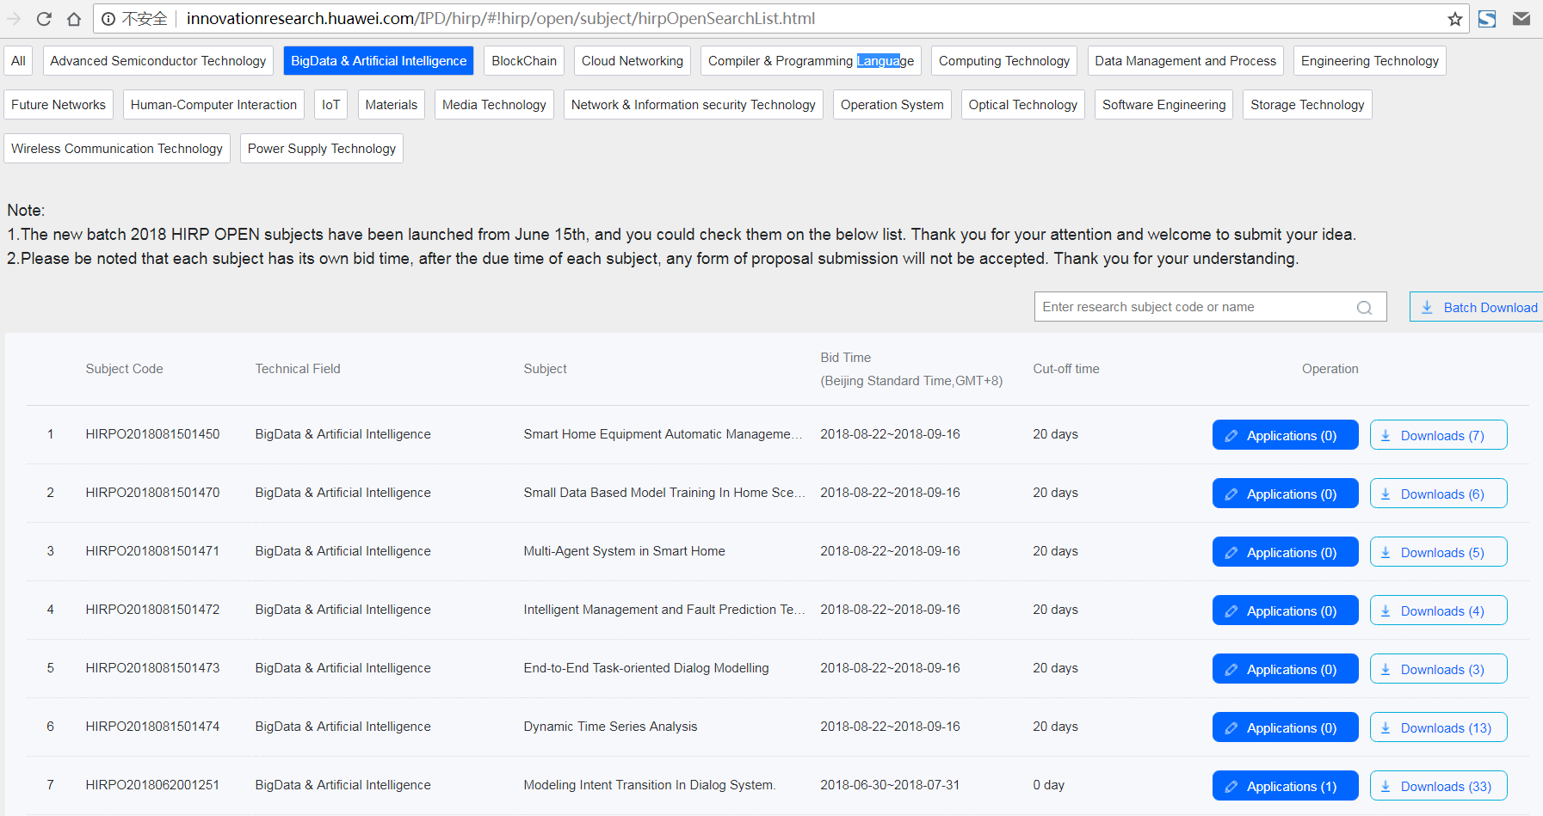
Huawei HIRP OPEN

Slide 38
More AI Labs
今日头条: http://lab.toutiao.com
科大讯飞
美团点评
好未来： http://ailab.100tal.com
Keep
商汤科技
大疆创新
深兰科技

Slide 39
Why NLP is hard?
“Any speaker of any human language can produce and understand an infinite number of sentences.”
(Fromkin, Rodman & Hyams. 2011. An Introduction to Language.)
Creativity!

Slide 40
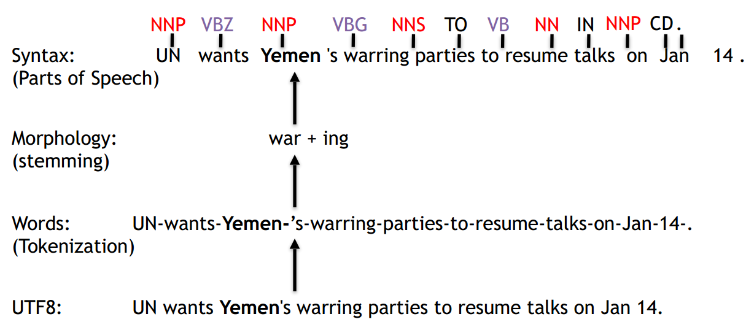
Layers of Linguistic Annotation

Slide 41
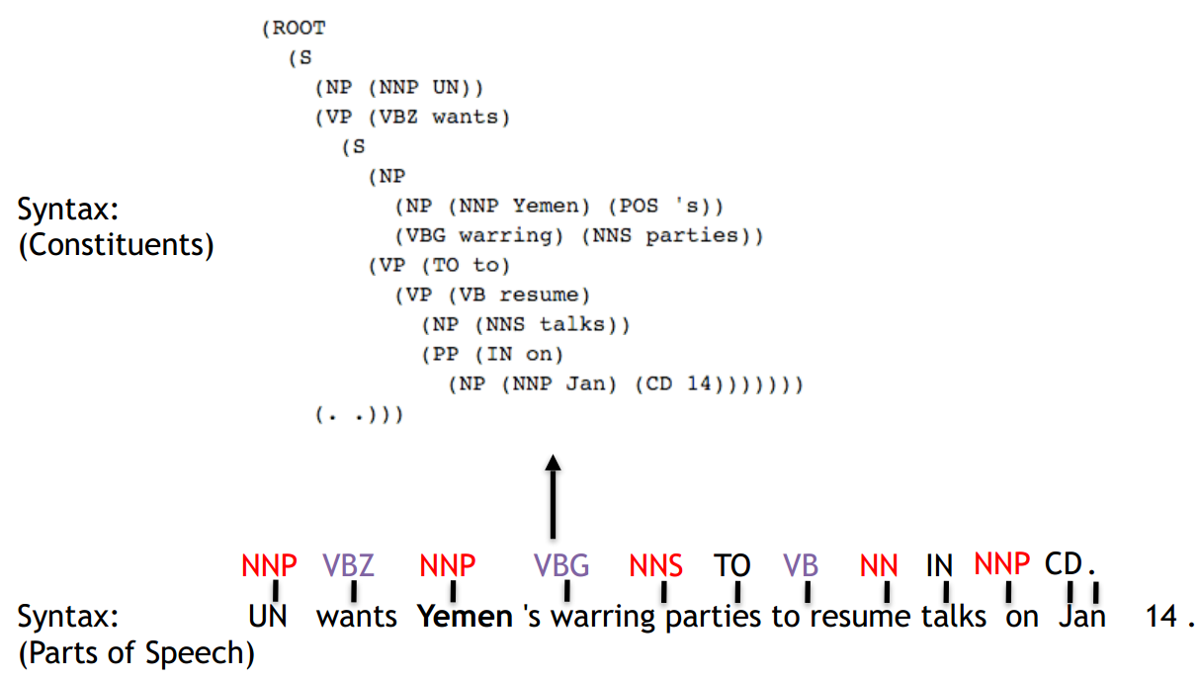
Layers of Linguistic Annotation

Slide 42
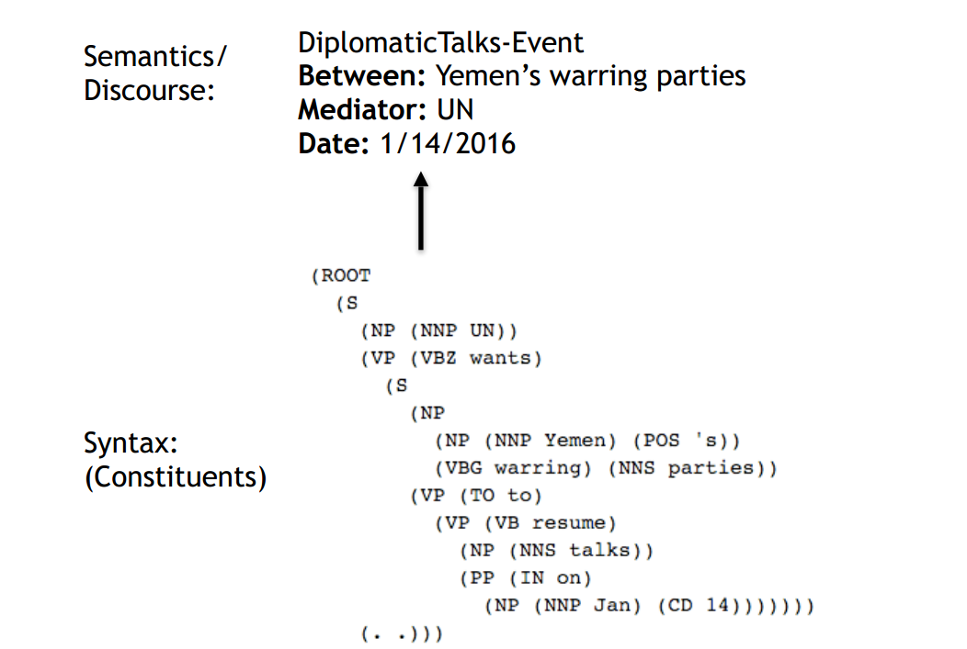
Layers of Linguistic Annotation

Slide 43
Why is NLP hard?
Why is it easy for computers to parse Python, but not English?
Ambiguity!

Slide 44

Structural Ambiguity

Slide 45

Structural Ambiguity

